Slide 1
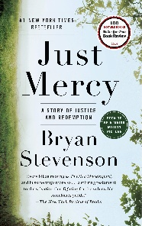
CONNECTING THE ISSUE OF VIOLENCE AGAINST WOMEN AND RACE THROUGH ACTIVE LEARNING ASSIGNMENTS
Dr. Miltonette Craig
(Illinois State University)
&
Dr. Shelly Clevenger
(Sam Houston State University)

Slide 2
Facilitating Discussions about
VIOLENCE AGAINST WOMEN
#SAYHERNAME project

Slide 3
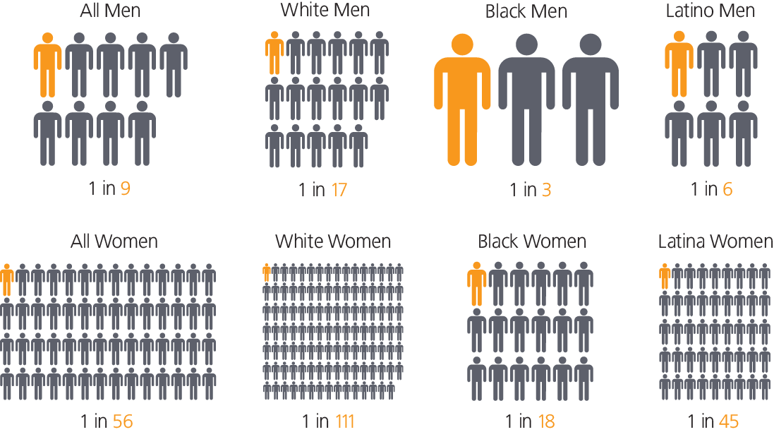
Facilitating Discussions about
RACE
https://www.sentencingproject.org/criminal-justice-facts/

Slide 4
Facilitating Discussions about
RACE
Flaws in the Criminal Justice System
Part I
Wrongful Convictions
Part II
U.S. Bail System
Part IV
The American Trial Jury
Part III
Indigent Defense System

Slide 5
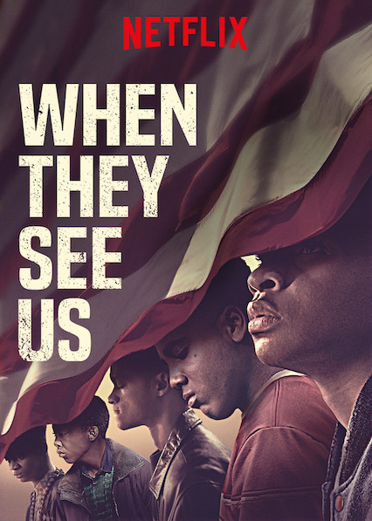
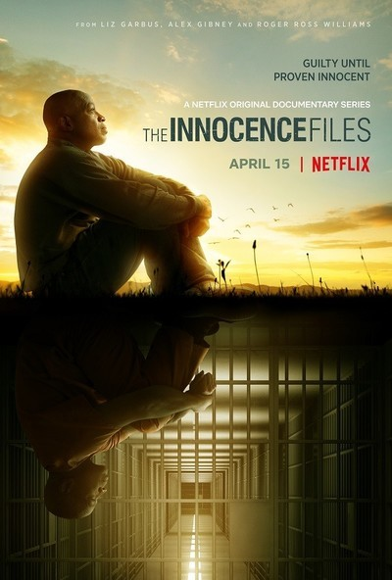
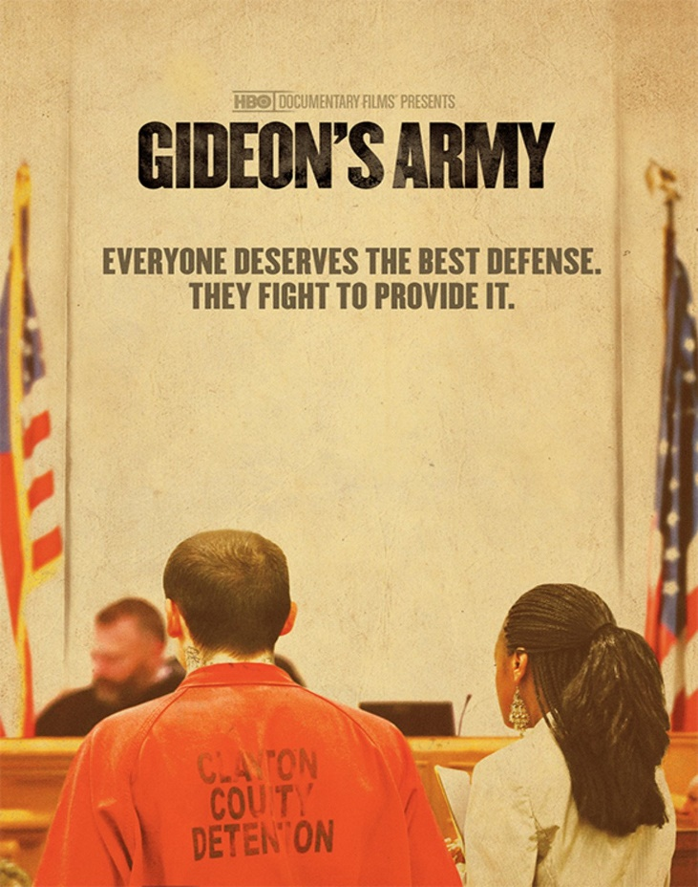
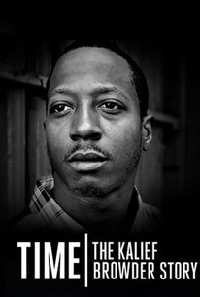
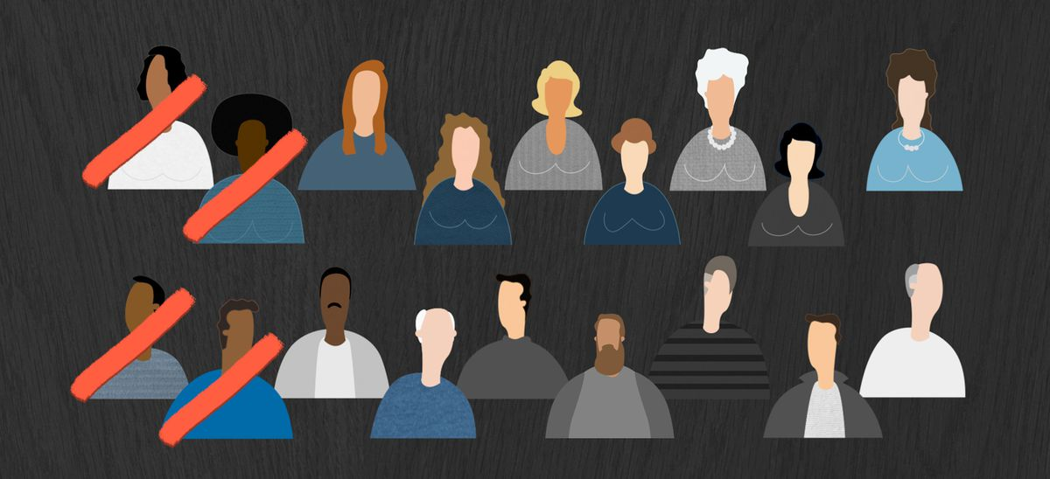
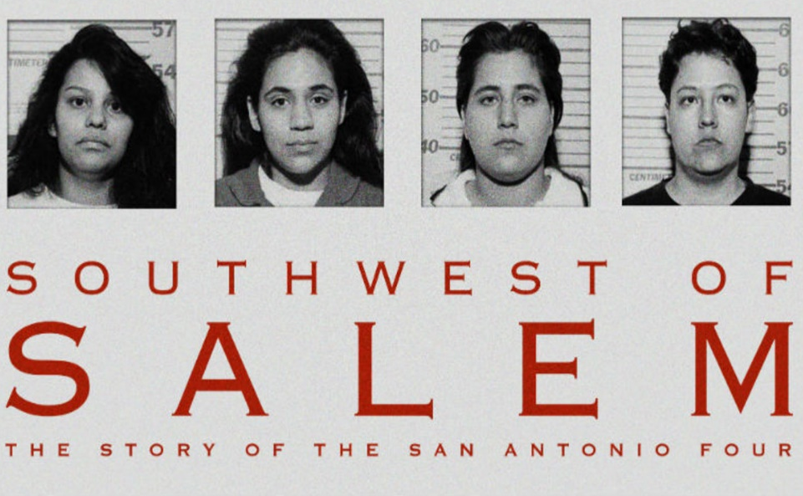
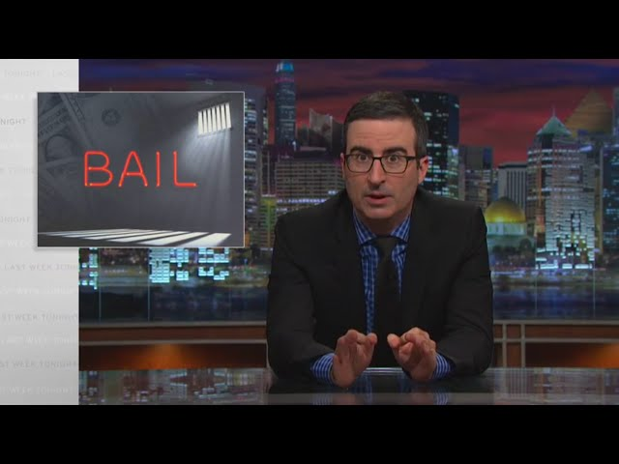
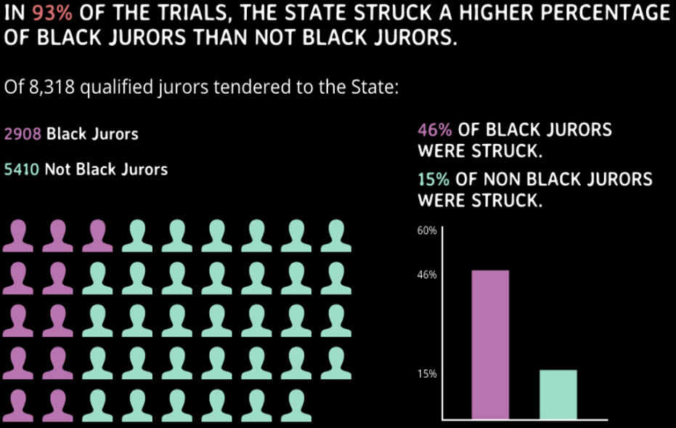
Facilitating Discussions about
RACE

Slide 6
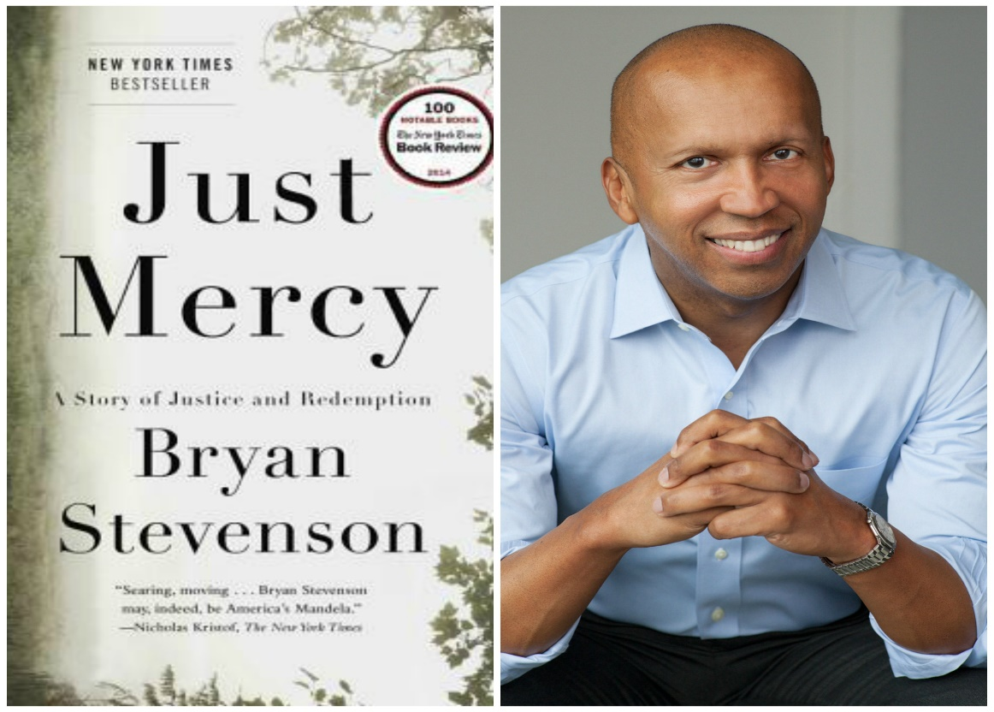
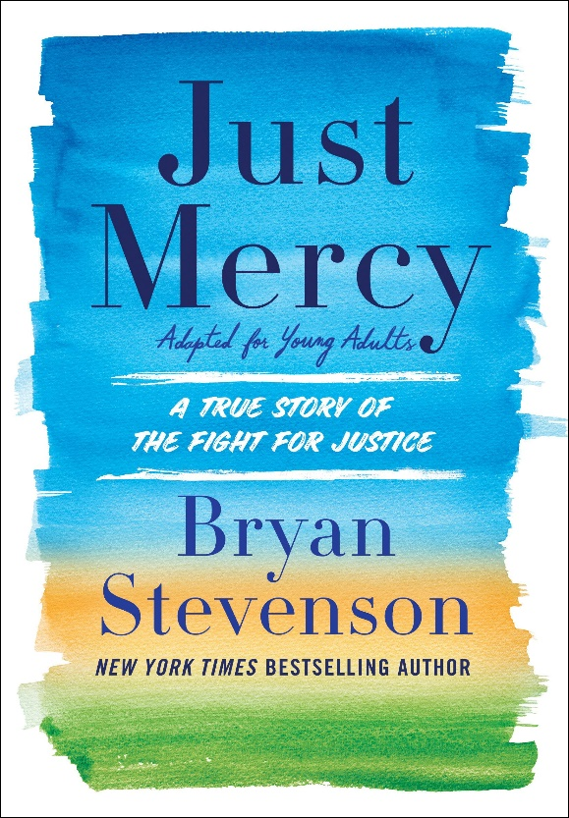
Facilitating Discussions about
RACE
After graduating from law school, Stevenson moved to Alabama to represent wrongfully convicted individuals. In the book, Stevenson focuses on one of his first clients, Walter McMillian, who was sentenced to death for the murder despite his innocence. Stevenson recounts his tireless fight for McMillian’s freedom and his encounters with racism, corruption, and injustice in the legal system.

Slide 7
Facilitating Discussions about
RACE
How much do you know about capital punishment in the United States?
#DPIC #EvolvingStandardsOfDecency #SCOTUS
Describe your reactions to reading the following lines?
Steve Bright: “[C]apital punishment means ‘them without the capital get punishment” (p. 5)
Bryan Stevenson: “[T]he opposite of poverty is not wealth; the opposite of poverty is justice” (p. 17)
What is your understanding of the term mitigation?
How is it relevant to the book?
What would be your response to someone who says they have innocence fatigue?
Can we (OR are we allowed to) get tired of this cause? Why or why not?

Slide 8
Facilitating Discussions about
RACE
Stevenson discusses “four primary institutions” that shape the conversation around race and justice.
How do we see this history of racial bias in the U.S. impacting prisons today?
#WacquantDeadlySymbiosis #AlexanderTheNewJimCrow #DuVernay13th
Monroeville is proud of the success of hometown hero Harper Lee—author of the 1960 award-winning To Kill a Mockingbird, about the false accusations and wrongful conviction a Black man in a racist legal system. Just 28 years later, McMillian was wrongfully convicted in this same town as a result of its on racism.
How would you explain this? What would you say to the community of Monroeville, AL?
Stevenson began his work in the early 1980s. Still, racially-charged, justice-related events are at the forefront of society
(e.g., Aurora, Louisville, Minneapolis, Atlanta, Kenosha, Rochester).
So how far have we come since then?
How can this book be a tool for society in the current sociopolitical climate?

Slide 9
Facilitating Discussions about
RACE
THIS IS WHAT WE NOT FINNA DO…
Use “fighting” words
Minimize someone’s lived experiences
Refuse to admit mistakes
Put the burden on BIPOC or presume BIPOC are a monolith
Forget to use diverse authors in course materials
Assume we know it all (invite guest lecturers!)

