Slide 1
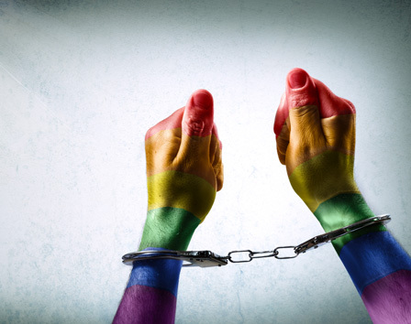
Teaching Criminology & Criminal Justice through a Queer Lens
Dr. Emily Lenning, Fayetteville State University
Notes:
Link to powerpoint, including hyperlinks is in the chat box.

Slide 2
A few things…
Queer issues belong across the curriculum
We have Queer students
Queer people are victims, offenders, and CJ practitioners
Be intentional
Notes:
1 – while queer issues can constitute a whole class, they should not be relegated to “special places” – we should teach Queer issues in core courses and electives at all levels
2 – teaching queer issues validates these students. But remember, they do not speak for ALL queer people – they are not the teacher, you are
3 – sometimes we focus solely on queer people as victims, and this perpetuates myths about queer people.
4 – do not “add queer and stir”, know your own limits – don’t teach about what you don’t know, but don’t avoid it – learn something new

Slide 3
Listen to hear, not respond.
What is said here stays here, but what is learned here leaves here
We MUST be responsible for the effect our words have on others
Assume there is always someone in the class with personal experience
We critique ideas, NOT people
It is never o.k. to declare a whole group of people wrong/sinful/sick because of anything (race, religion, gender, sexuality, appearance, etc.)
Notes:
It is important to establish ground rules in any class, but especially when discussing “sensitive” issues. These are just a few of the ground rules I use in my classes.

Slide 4
Case-based Modules
Potential classes
Connected topics
Assigned materials
Informal Conversation & Assignment Prompts
Activities
Notes:
I like to use specific cases because t 1) interests students, 2) humanizes queer people, 3) allows for the application of concepts to real examples
Given the online focus of the teach-in, all of the activities here can be used online, but certainly can be adapted for f2f classes

Slide 5
The San Antonio Four
Notes:
Elizabeth Ramirez, Cassandra Rivera, Kristie Mayhugh, and Anna Vasquez. Four Latina lesbians accused and convicted of gang-raping Elizabeth’s 7 and 9 year old nieces during a supposed satanic ritual. Their sentences ranged from 15 to 37 years. They each spent 15 years behind bars before they were exonerated (which only happened because a film gained national attention). This case is great to use for classes that focus on media representation, wrongful convictions, moral panic (satanic panic), or intersectionality. I use it in the gender and punishment module of my undergraduate Race, Class & Gender in CJ course where I tend to focus on the intersectional issues of the case.

Slide 6
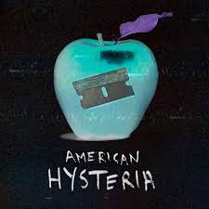
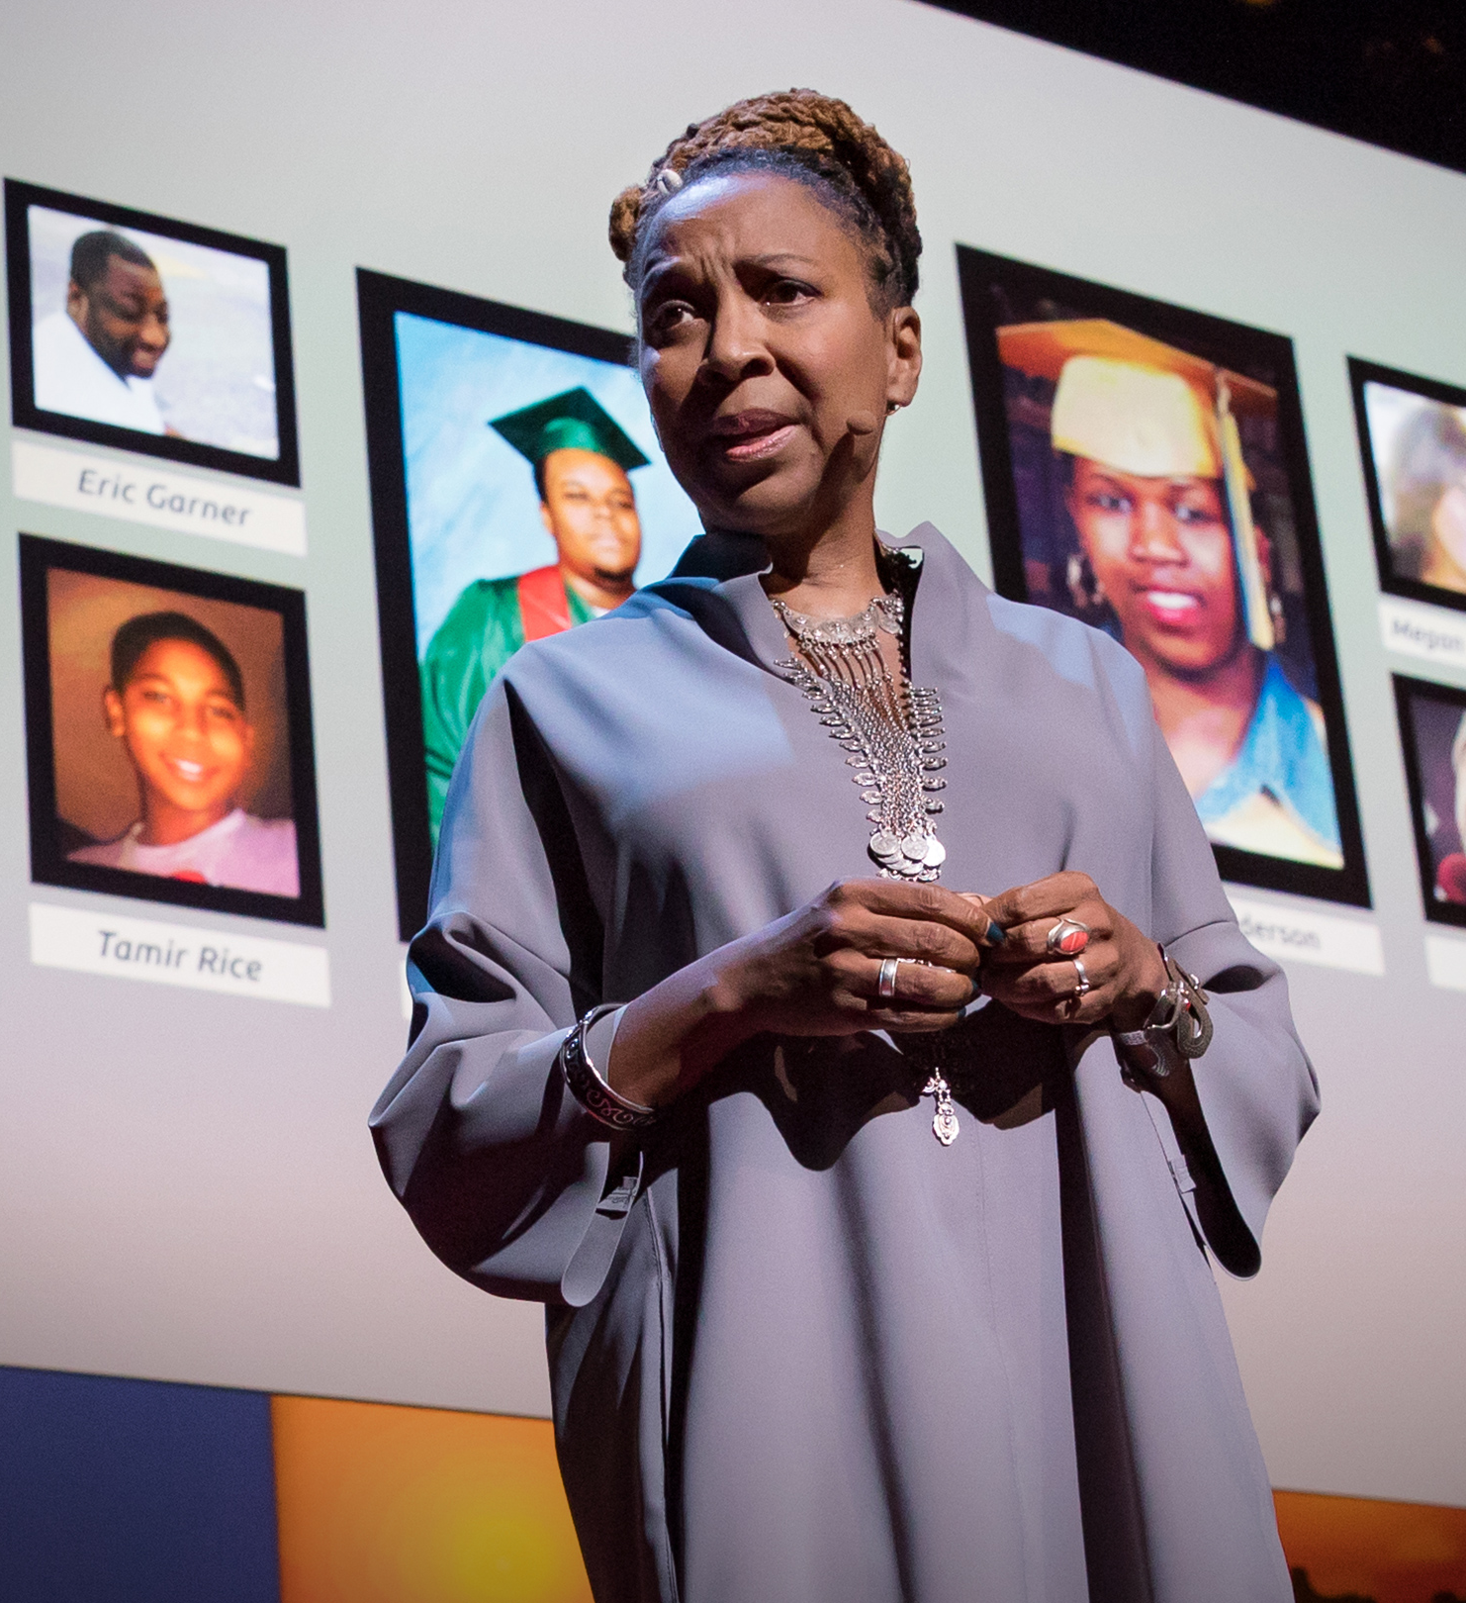
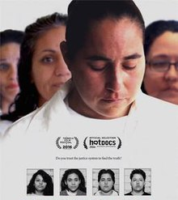
Materials
Southwest of Salem: The Story of the San Antonio Four (available on Kanopy, rent on YouTube, currently free on Tubi)
Buist, C.L. & Lenning, E. (2016). Queer criminology. New York: Routledge. (Chapter 5)
Chesney-Lind, M & Eliason, M. 2006. From invisible to incorrigible: The demonization of marginalized women and girls. Crime, Media, Culture, 2, (1): 29-47.
TEDTalk: The Urgency of Intersectionality
American Hysteria: Episode 4 (Satanic Panic Part 1) and Episode 5 (Satanic Panic Part 2)
Retro Report: The Preschool Sex Abuse Case that Changed How Molestation is Investigated

Slide 7
Informal Conversation Prompts
How does the case of the San Antonio 4 relate to intersectionality?
After watching the film, find out "where they are now" by doing a Google search
How does the case relate to the 5 faces of oppression?

Slide 8
Five “Faces of Oppression” ~Iris Young
Exploitation the action of treating someone unfairly in order to benefit from their work.
Marginalization preventing or limiting someone’s full participation in society through exclusion (from, for example, the job market, health care system, public beneﬁts programs, or community activities).
Powerlessness is a deprivation of the ability to make decisions about one’s living or working conditions.
Cultural imperialism is the valuing and enforcement of the dominant group’s culture, norms, and characteristics.
Violence includes physical, sexual, and emotional violence, and the threat of violence, as well as policies and structures that condone violence.

Slide 9
Assignment Prompt
First, discuss the connections between what Chesney-Lind & Eliason have to say about the media and popular constructions of “criminal” girls and women and the San Antonio 4 case. How do stereotypes about women of color and lesbians contribute to the “criminalization” of women? Then, reflect on the complexities of the San Antonio 4 case. How does intersectionality play a role in this case? Would the case have played out differently (if so, how) if the women were not Hispanic lesbians? What if the “perpetrators” and the “victims” were male? Now that the San Antonio 4 have been released, what barriers will they face? What implications does this case have for the LGBTQ community? Finally, do you think justice was served in this case (why or why not)?

Slide 10
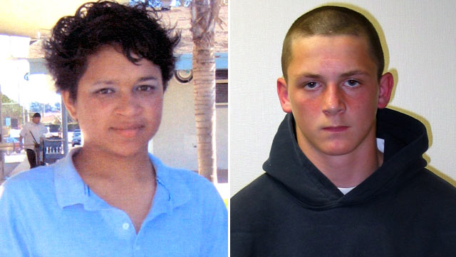
Larry King
Notes:
Larry (Latisha) King was a 15 year old gay (possibly trans) From Oxnard, CA who was shot twice (in a computer lab in front of students) by his 14 year old classmate Brandon Mcinerny in 2008 after he asked Mcinerny to be his Valentine. Both children had difficult backgrounds – Larry was born to a crack addicted mom, had run-ins with law enforcement, and was living in a group home when he died. Brandon’s mother was addicted to meth and his parents had a very serious history of domestic violence, which Brandon frequently witnessed. He was also beginning to dabble in white supremacy. Given the complexity of this case, it can apply to a lot of issues in a variety of classes. It is perfect for victimology, sentencing and juvenile justice issues (controversy over Brandon’s sentence – he received 21 years), hate crimes, gay panic defenses, white supremacy and/or toxic masculinity. I use the King case in my undergraduate Sex, Sexuality & the Law course when we focus on hate crimes.

Slide 11
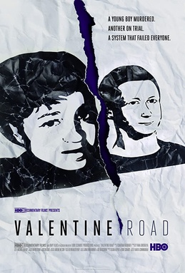
Materials
Valentine Road (currently FREE on YouTube)
Bufkin, J.L. 1999. Bias Crime as Gendered Behavior. Social Justice, 26, (1): 155-176.
Buist, C.L. & Lenning, E. (2016). Queer criminology. New York: Routledge. (Chapter 5)
Meyer, D.2014. Resisting hate crime discourse: Queer and intersectional challenges to neoliberal hate crime laws. Critical Criminology, 22: 113–125.
FBI data on Hate Crimes (Data Scavenger Hunt - Online or F2F)

Slide 12
Informal Conversation Prompts
Tell us what you learned from the FBI Hate Crime Data (*especially be sure to click on "Incidents & Offenses and explore Table 1). Were you surprised by what you learned?
How accurate do you think the FBI data is? What might cause the number of offenses to be underestimated (remember, this data comes from the Uniform Crime Reports)?
Besides Larry King, can you think of any other people who were victims of a hate crime due to their sexual orientation and/or gender identity? How did you hear about those cases?

Slide 13
Assignment Prompts
Begin by describing the FBI’s 2018 Hate Crime data – explain to your reader how many hate crimes were motivated by sexual orientation bias, gender identity bias, and provide statistical details about those two categories. Then, given the assigned readings, explain how Jana Bufkin would explain the causes of these hate crimes in general, Larry King’s murder in particular (use examples from the film). Finally discuss the pros and cons of hate crime legislation as described in Chapter 5 of Buist & Lenning.

Slide 14
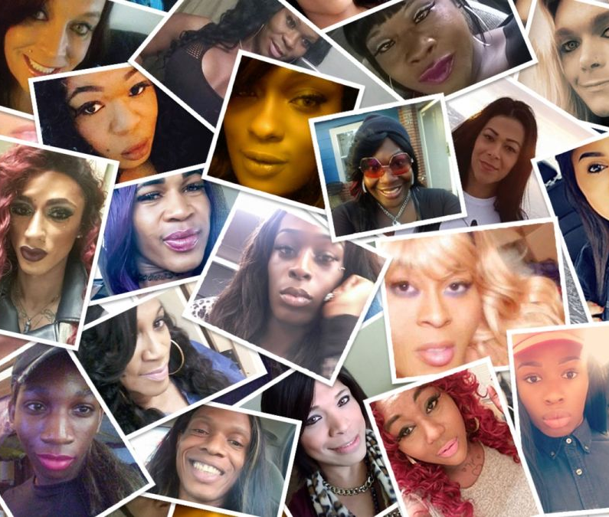
Violence against Transgender Women of Color
Notes:
Violence against trans people, especially trans women of color, has been called a national epidemic by the AMA and HRC, and exploring these cases can connect to a lot of issues we cover in a variety of classes – victimology, VAW, classes that focus on hate crimes, intersectionality, law enforcement interaction with trans folks, problems with data collection, media representation (or lack thereof), the relationship between violent ideology (transphobia), violent policies (like bathroom bills), and violent actions (murder). I include a focus on the murders of trans women of color in three classes: Sex, Sexuality & the Law, Race, Class, Gender & Crime, and my graduate level Race, Crime & Justice course.

Slide 15
101 Materials
Transgender 101 – UC Davis
What are Pronouns and Why Do They Matter?
The Breakdown with Shaun King: Episode 36 Black Trans Women are being Murdered
Notes:
Whenever addressing LGBTQ issues, especially trans issues, it is important to make sure students have a basic understanding. These are a few 101 “refresher”/prep materials I post for my classes (undergrad and grad – never assume that someone has base knowledge, especially re: trans people).
Getting students to use proper pronouns can be a frustrating battle, but one worth fighting

Slide 16
Materials
Graham, L.E. (2014). Navigating community institutions: Black transgender women’s experiences in schools, the criminal justice system, and churches. International Journal of Transgenderism, 15, (2): 100-115.
Human Rights Campaign Foundation. (2019). A national epidemic: Fatal anti-transgender violence in the United States in 2019.
James, S. E., Brown, C., & Wilson, I. (2017). 2015 U.S. Transgender Survey: Report on the Experiences of Black Respondents. Washington, DC and Dallas, TX: National Center for Transgender Equality, Black Trans Advocacy, & National Black Justice Coalition.
James, S. E. & Salcedo, B. (2017). 2015 U.S. Transgender Survey: Report on the Experiences of Latino/a Respondents. Washington, DC and Los Angeles, CA: National Center for Transgender Equality and TransLatin@ Coalition.
Notes:
I use these for my graduate Race, Crime and Justice course

Slide 17
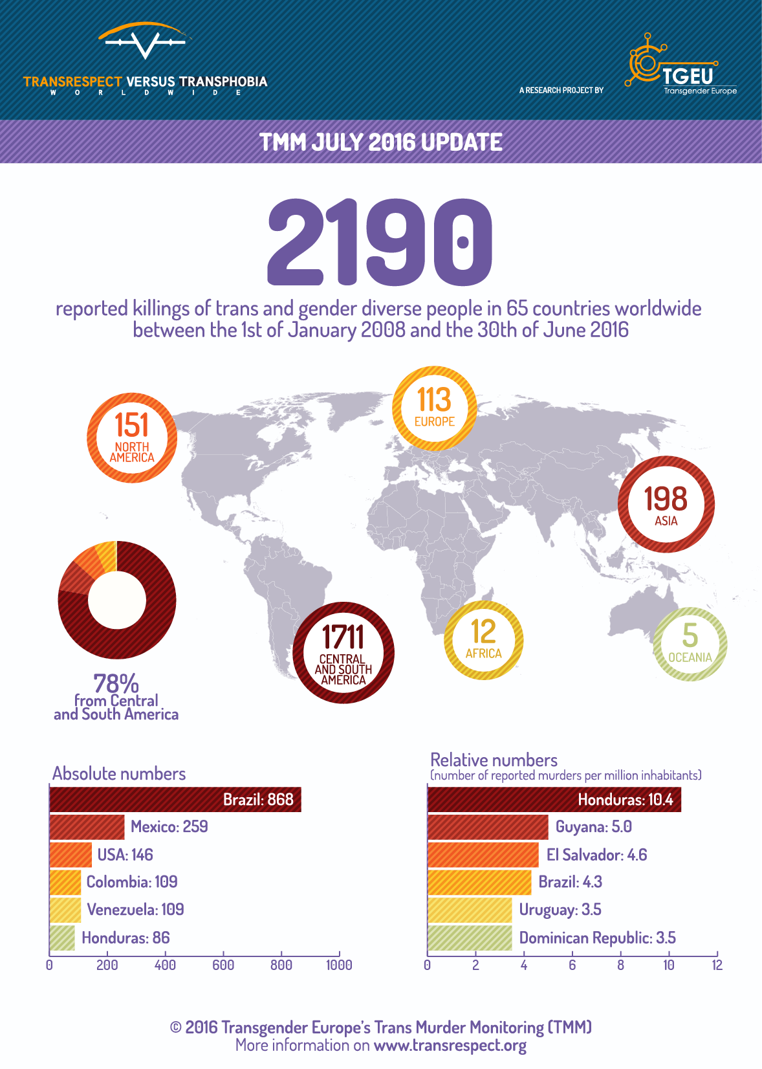
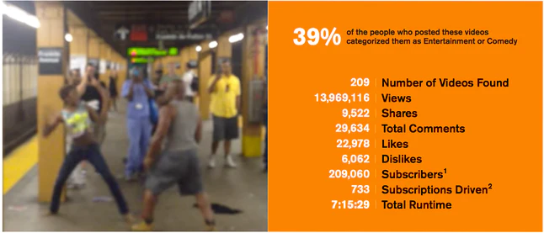
Additional Materials
Lenning, E., Brightman, S. & Buist, C. 2020. The trifecta of violence: A socio-historical comparison of lynching and violence against transgender women. Forthcoming in Critical Criminology
Retro Report: Transgender rights: A decades-long struggle for equality
Trans Murder Monitoring Map (2008-2016)
Witness Media Lab: Capturing Hate
Notes:
TMM

Slide 18
Informal Conversation Prompts
What have you learned this week that you didn't know before?
You are looking at a lot of data this week - what has struck you the most about that data?
You are investigating cases from 2020, but here are a few names of victims from previous years for you to Google and discuss: Muhlaysia Booker, Ally Lee Steinfeld, Kenne McFadden
Why are trans women of color at greater risk of victimization than white trans women?

Slide 19
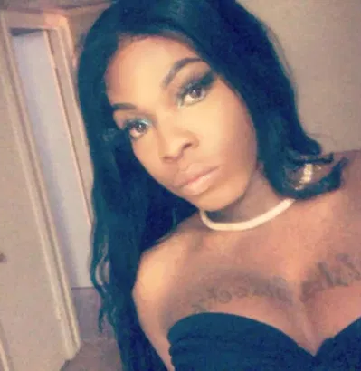
Activity: Investigate a Case
Investigate your case
Jot down details of case – be prepared to share with class
Discuss whether or not the homicide should be considered a hate crime (criminal act motivated by bias) – be prepared to give specific reasons
Not what the media thinks, but what YOU think based on what you learn
If it might be considered a hate crime, how does it relate to our list of motivations?
Whether or not you think it is a hate crime, find out if the homicide would classify as a hate crime in the state that it occurred (Movement Advancement Project)
Notes:
Cases – put names in a hat, discuss misgendering, deadnaming – follow up discussion about sources (mostly non-mainstream), victim blaming, etc.

Slide 20
Assignment Prompt
Review the Human Rights Campaign list of Violence Against the Transgender and Gender Non-Conforming Community in 2020. Choose at least one of the victims listed and learn more about their case by doing some “sleuthing” on the internet. Once you have read the assigned materials and investigated your chosen case, you should write a formal essay that accomplishes the following:
Describe the experiences of trans people of color, including data that you think is particularly important to be aware of. What does this data tell us?
Analyze these experiences through an intersectional lens, connecting them to issues/concepts/ideas from previous weeks
What do these experiences tell us about society broadly and the criminal legal system specifically?
Incorporate your victims’ case into your essay somehow. Describe the case and discuss what you learned about it. Why is it important to learn about these victims?

Slide 21
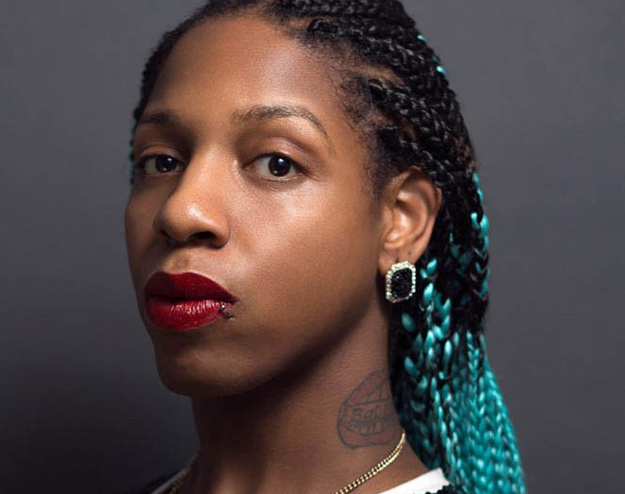
CeCe McDonald
Notes:
CeCe is a Black bisexual trans woman was sentenced to 41 months (in a mens prison) after accepting a plea bargain for second degree manslaughter. In 2011, McDonald was assaulted by a white woman outside of a bar as several people yelled racist and transphobic remarks at her, including “You n******s need to go back to Africa” and “Look at that boy dressed as a girl, tucking his dick in.” Her attacker dragged her to the ground and slashed her face with a broken glass. As she tried to leave the scene, her assailant’s ex-boyfriend ran after her, and McDonald fatally stabbed him with a pair of scissors. CeCe served 19 months of her sentence and became a visible part of the trans rights movement when Laverne Cox brought the case to the attention of the media. Her case works for a variety of classes, including corrections, victimology, race/class/gender. I use her case to discuss plea bargaining, victim blaming, correctional policies, and trans issues.

Slide 22
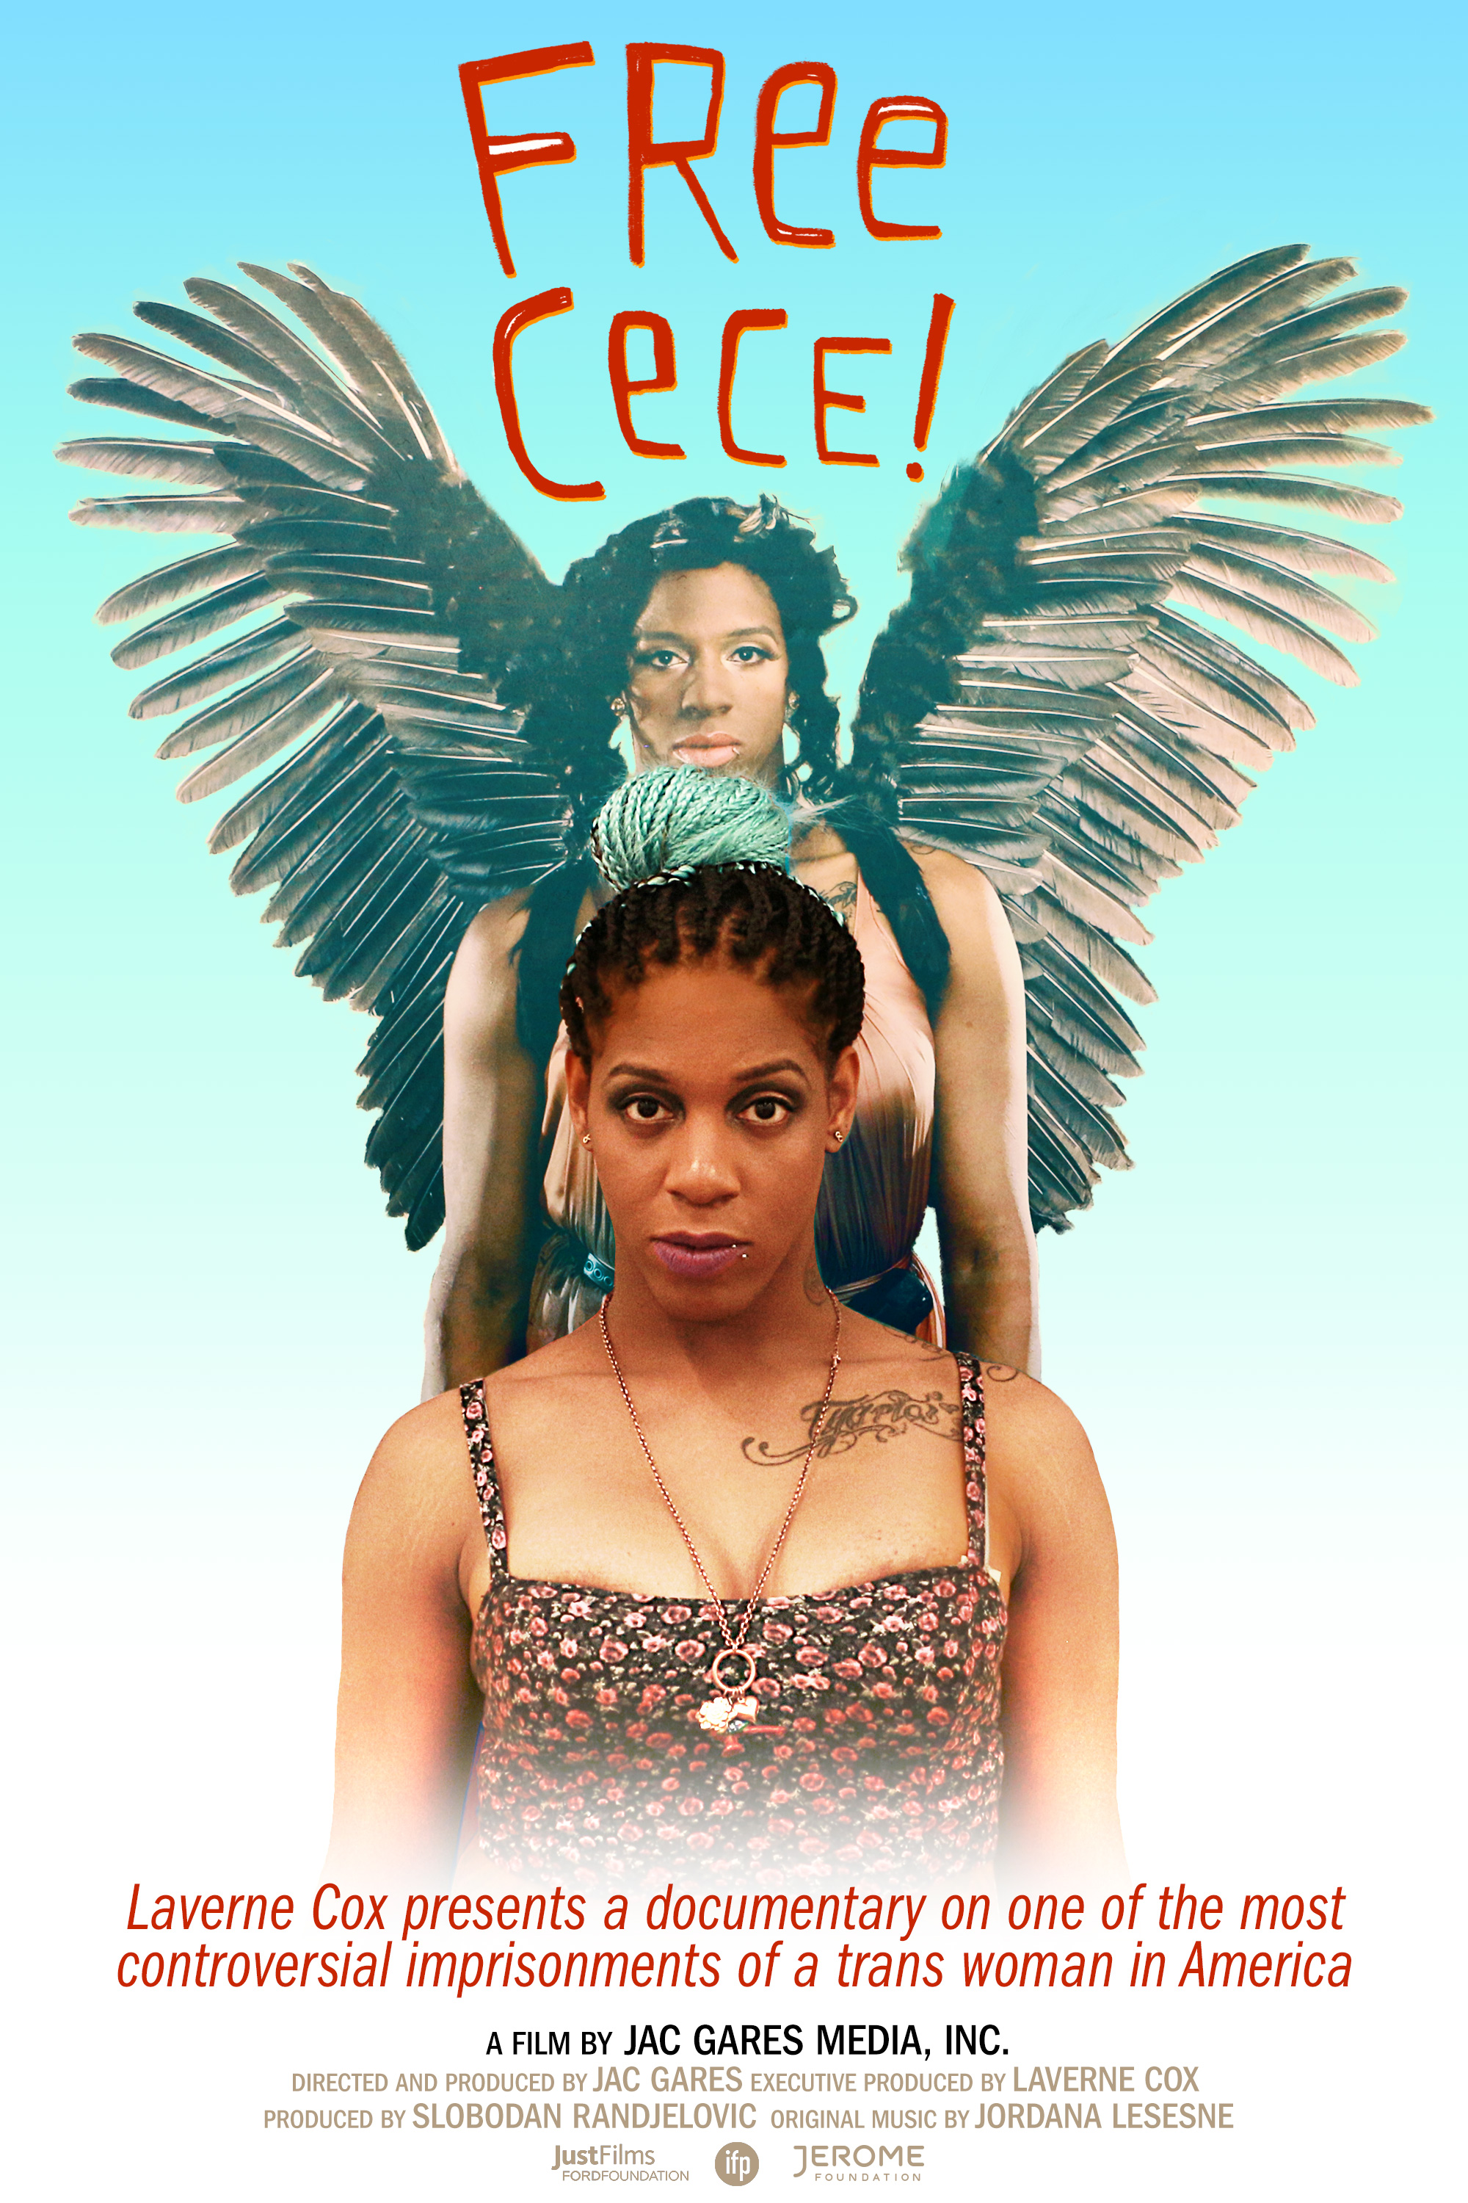
Materials
Free CeCe! (Available for rent on Vimeo)
Buist, C.L. & Lenning, E. (2016). Queer criminology. New York: Routledge. (Chapter 6)
Lenning, E. & Buist, C. 2018. A crisis behind bars: Transgender inmates, visibility & social justice. In Jackson, S. & Gordy, L. (eds.) Caged Women: Incarceration, Representation, & Media. New York: Routledge.
Buist, C. & Lenning, E. 2016. Gender Issues in Corrections. In Walsh, J. & Hilinski-Rosick, C. (eds.) Issues in Corrections: Research, Policy and Future Prospects. Rowan & Littlefield.
Black & Pink: Queer Abolition group
Ear Hustle: Season 1, Episode 18: Down Low
Notes:
Gender Issues in Corrections is a unique chapter because it focuses on cisgender and transgender women and provides a critique of gender-responsive policies (inasmuch as they are actually sex-responsive policies)

Slide 23
Informal Conversation Prompts
What have you learned this week that you did not know before?
What was it like hearing directly from inmates on Ear Hustle and in the Black & Pink newsletter?
How do you think these forms of media (podcasts and newsletters) could impact inmates, either positively or negatively?

Slide 24
Activity: Imaginary Pen-Pal
Imagine that you have decided to write an incarcerated LGBTQ person. You have been paired with a transgender woman named Daisy who has recently been convicted of a felony and sentenced to 18 years in prison. Daisy has not yet undergone complete gender affirming surgery, but has taken hormones for the last seven years and has breast implants. Drawing upon the assigned chapters, the podcast, and the newsletters you browsed, write Daisy a letter that tells her about what she might expect (both positive and negative) while she is incarcerated.

Slide 25
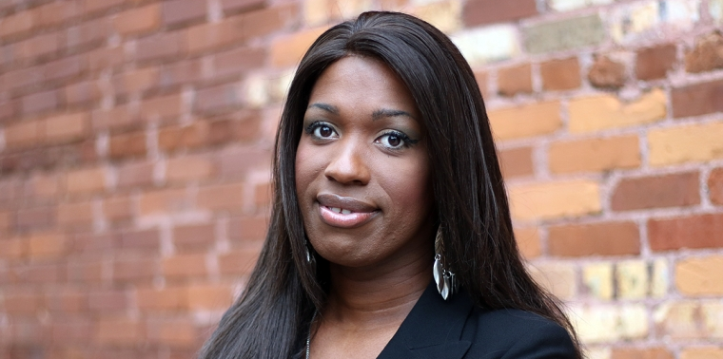
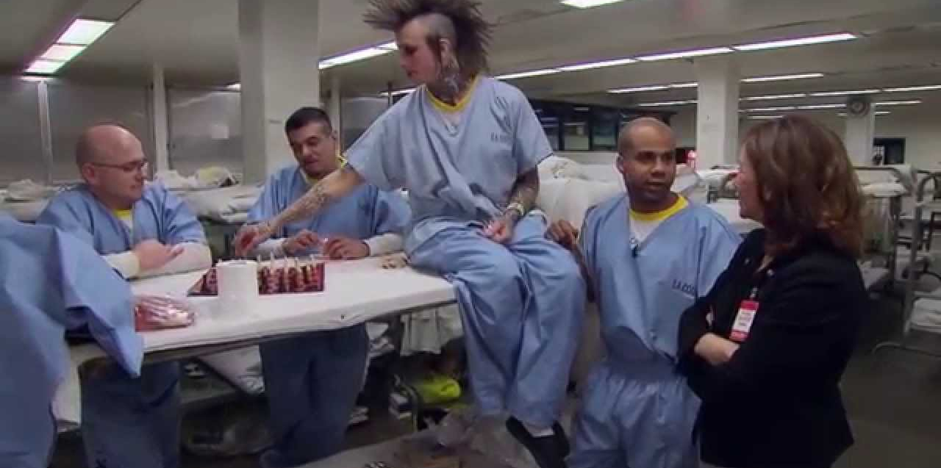
Additional Case Studies in Corrections
K6G: LA County Men’s Jail
Meghan Frederick v. California Dept. of Corrections
Ashley Diamond
Notes:
K6G is a wing for gay, bisexual and trans inmates (about 360 inmates) – if you are teaching comparative CJ there is a gay/trans prison in Thailand
Meghan is a trans woman who transitioned while working as a CO in a California prison. She sued the DOC for creating a hostile work environment when co-workers called her tranny and harassed her – her case would be great for corrections, courts, or a class on CJ employees – she settled for $500,000
Ashley sued the Georgia DOC for failure to provide medical treatment when they cut off the hormones she had been taking for 17 years. She also suffered sexual assault while incarcerated and was locked in solitary for her own “protection.” Ashley’s case is unique because the Dept. of Justice backed her lawsuit – her case would work for corrections (maybe couched within a broader discussion about medical treatment in prisons, courts, etc.

