Slide 1
DWC TEACH-IN September 4, 2020: Session #8
FYI: This session will be recorded for those who cannot attend to watch later.
I will announce when recording begins. Please feel free to:
Turn off your video and/or change your name for anonymity
Exit the session and watch the recording later
Request a one-on-one conversation with the facilitator for further (uncensored) discussion after the session if you are uncomfortable asking questions or contributing during the recording session

Slide 2
DWC TEACH-IN SESSION #8: LIGHTS, CAMERA, ACTION! INCORPORATING ROLE PLAYING AND MEDIA IN RACE AND GENDER ONLINE COURSES
DR. STACIE MERKEN, ASSISTANT PROFESSOR
INDIANA UNIVERSITY SOUTH BEND

Slide 3
Presentation agenda!
Discussion of assignments for role playing for both race and gender online courses
Discussion of assignments for media incorporation for both race and gender online courses
Brief discussion of rubric issues for active learning assignments
Questions???
Sharing!

Slide 4
ROLE PLAYING ASSIGNMENTS FOR RACE AND/OR GENDER ONLINE COURSES
Reacting to the Past (RTTP)
*Mark Carnes (1990) Barnard College
*Original or modified
*Mary Jane Treacy: Greenwich Village 1913: Suffrage, Labor, and the New Woman
*Kelly McFall & Abigail Perkiss: Changing the Game: Title IX, Gender, and College Athletes

Slide 5
ROLE PLAYING ASSIGNMENTS FOR RACE AND/OR GENDER ONLINE COURSES
Other forms of role playing!
1. U.S. Supreme Court Justices
2. Courtroom Workgroup
3. Journal assigned roles
4. Debate assigned roles

Slide 6
INCORPORATING MEDIA!
Journal entries (myths, issues, and realities)
Social media assessments

Slide 7
BRIEF NOTE ABOUT GRADING RUBRIC ISSUES FOR ACTIVE LEARNING
Subjectivity vs. objectivity
*Shy/timid/introverts vs. outgoing/extroverts
*Rewarding language!

Slide 8
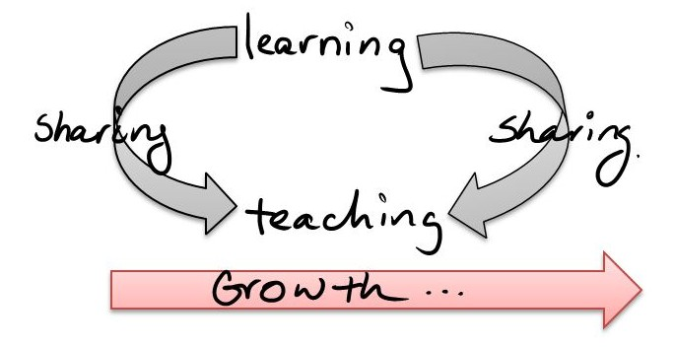
QUESTIONS AND SHARING!

